Slide 1
Obesity-Related Comorbidities
Diabetes

Slide 2
Obesity Related Conditions

Slide 3
Learning Objectives
Understand the relationships between obesity and all-cause mortality
Explain how age modified obesity-associated disease risks
Describe the normal physiology of glucose regulation, including the key roles of pancreas, muscle, liver and adipose tissues
Describe the progression of obesity-associated type 2 diabetes including the pathophysiology of these changes
Apply your knowledge of glucose homeostasis to explain how individuals may progress towards type 2 diabetes differently

Slide 4
Obesity and All-Cause Mortality
Similar effects for males
Increased risk at low and high BMI
Adams KF, Schatzkin A, Harris TB, Kipnis V, Mouw T, Ballard-Barbash R, Hollenbeck A, Leitzmann MF. Overweight, Obesity, and Mortality in a Large Prospective Cohort of Persons 50 to 71 Years Old. N Engl J Med. 2006; 355: 763–78. doi: 10.1056/NEJMoa055643.

Slide 5
What do you think is going on here?
Why is risk increasing dramatically from BMI 25+
Why is risk increasing below BMI of 25?

Slide 6
Obesity-Related Causes of Death
2002 data
Flegal KM, Graubard BI, Williamson DF, Gail MH. Cause-Specific Excess Deaths Associated With Underweight, Overweight, and Obesity. Jama. 2007; 298: 2028. doi: 10.1001/jama.298.17.2028.

Slide 7
Obesity and Loss of Healthy Years
Nyberg, S. T. et al. Obesity and loss of disease-free years owing to major non-communicable diseases: a multicohort study. Lancet Public Heal. 2667, 1–8 (2018).
Notes:
Loss of 7-10 years without type 2 diabetes, coronary heart disease, stroke, cancer, asthma, and chronic obstructive pulmonary
disease

Slide 8
Childhood obesity relative risks
Relative Risk of death from all causes compared to normal weight adolescents:
1.4-2.0X
Why might these risks be higher than adult onset obesity?
Disease | Adolescent Obesity
Adult Obesity | 1.4-2.8X
Cardiovascular Disease | 2.0-5.1X
Diabetes | 1.9-2.6X
NAFLD | 1.3X
Notes:
Prospective study in norwegian adolescents

Slide 9
“Is Metabolically Healthy Obesity Healthy?”
News Presentation
Maddy Schmitter

Slide 10
Metabolically Healthy Obesity
Metabolically Healthy Obesity: No formalized definition, but generally stated as the absence of metabolic diseases and lack of major risk factors
Metabolic diseases include diabetes, high blood pressure, and high cholesterol
Thought to be influenced by lifestyle factors and genetics
Conflicting results on relationship to cardiovascular disease

Slide 11
“Healthy Obesity not so Healthy for the Heart”
Medical News Today, 2018
“a new study on women suggests that the "healthy" attribute should be taken with a considerably large pinch of salt”
Literature review of long term studies revealed individuals with obesity were at a higher risk of cardiovascular disease than normal weight participants
Cohort study using data from the Nurses Health Study shows same pattern
Everyone should take measures to promote metabolic health regardless of weight

Slide 12
Scientific Article
“Cardiovascular disease risk of women with metabolically healthy obesity was increased compared with women with metabolically healthy normal weight, but risk was considerably higher in women with metabolically unhealthy normal weight, overweight, and obesity”
Increased rate likely to do a transition from metabolically healthy obesity to metabolically unhealthy over study course

Slide 13
Comparison
News article presented factual information in a slightly biased format
Different hypotheses presented
Scientific: “the onset of metabolic disorders increases cardiovascular disease risk in individuals who were initially metabolically healthy”
News: “obesity free of metabolic diseases may not heighten a person’s risk of CVD, in the long-term, it may lead to the same negative effects on cardiovascular health as other types of obesity”.
Scientific does not mention obesity

Slide 14
Implications
Promotion of healthy behaviors among all populations regardless of weight
Weight Stigma
Priority of intervention and resources

Slide 15
Discussion
Why do you think this news article presented the scientific information the way it did?
Is there anything that should be changed regarding the public health approach to obesity given this information?
How large should the increase in adverse health outcomes caused by metabolically healthy obesity be to be considered a public health issue?

Slide 16
Type 2 Diabetes and Obesity

Slide 17
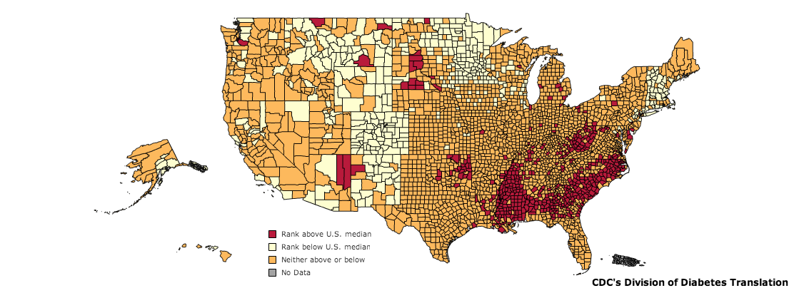
Diabetes in the United States
Incidence
1.9M Americans
79M are prediabetic
CDC, 2010
Notes:
As of 2011, diabetes affects 25.8 million people or 8.3% of the population. This includes approximately 7 million undiagnosed individuals. In addition to this, 79 million Americans over the age of 20 are estimated to be pre-diabetic. As of 2007, diabetes is estimated to cost $116 billion in direct and $58 billion in indirect costs [@CDC2011].
Diabetes is especially prevalent in this region. As shown in the map, there is a higher percentage of diabetics in the mid and deep south regions of the United States.

Slide 18
Some side effects of diabetes
Leading cause of
Kidney failure
Non-trauma related amputations
Blindness
Major cause of
Stroke
Death (7th leading cause)

Slide 19
Overall Associations of BMI with Diabetes Risk

Slide 20
How does this happen?
Glucose Regulation

Slide 21


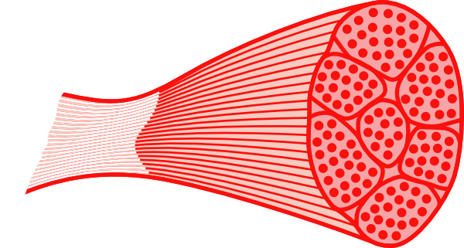
Regulation of Blood Glucose Levels
Gluconeogenesis
Disposal
Glucose Uptake
Glucose Storage
Glucose Utilization
Glucose Production
Glucose Uptake
Glucose Storage
and Utilization
Notes:
Ask for some examples of how glucose is stored, or how it is utilized

Slide 22
Insulin reduces blood glucose
Released by beta cells of the pancreas
Removes glucose from the blood by stimulating uptake in fat and muscle
Promotes fat storage
Stops glucose production (gluconeogenesis) in the liver

Slide 23
Obesity is associated with insulin resistance
Type 2 Diabetes is characterized by insulin resistance
Muscle cannot take up glucose (after a meal)
Liver does not stop producing glucose (while fed)
Insulin-Stimulated glucose uptake
DeFronzo RA. Lilly lecture 1987. The triumvirate: beta-cell, muscle, liver. A collusion responsible for NIDDM. Diabetes. 1988; 37: 667–87. doi: 10.2337/diab.37.6.667.

Slide 24
Exercise Also Improves Glucose Disposal
Exercise-dependent glucose uptake still occurs even in the insulin resistant
Holten, M. K. et al. Strength Training Increases Insulin-Mediated Glucose Uptake, GLUT4 Content, and Insulin Signaling in Skeletal Muscle in Patients with Type 2 Diabetes. Diabetes 53, 294–305 (2004).

Slide 25
Obesity is associated with hyperinsulinemia
Nutritional overload
Protective insulin resistance
Tissues respond worse to insulin
More insulin is secreted
Tissues more desensitized
More insulin is secreted
Eventually beta cells cannot compensate

Slide 26
Pancreatic Beta-Cell Expansion
Some individuals become very insulin resistant but do not become diabetic
Excellent beta cell expansion
Very high insulin levels

Slide 27
Obesity Related Progression of Diabetes

Slide 28
Varied progression from obesity to T2D
What are some individual physiological factors that could alter the obesity-diabetes relationship?
Could convert glucose to fat less efficiently
How much fat they can store before developing peripheral insulin resistance
Beta cells could keep increasing insulin production for longer

Slide 29
Genetic Risk Factors for Obesity-Associated Diabetes

Slide 30
Diabetes as an emerging global health epidemic
442M in 2014
4 fold increase since 1980
Three reasons
Large populations
Increasing obesity
Higher risk at lower obesity

Slide 31
Ethnic Differences in the BMI-Diabetes Relationship
Chiu M, Austin PC, Manuel DG, Shah BR, Tu J V. Deriving ethnic-specific BMI cutoff points for assessing diabetes risk. Diabetes Care. 2011; 34: 1741–8. doi: 10.2337/dc10-2300.

Slide 32
Type 2 Diabetes and Lipodystrophy
GWAS of people with:
Normal BMI
Elevated fasting insulin/glucose
Found genes expressed in adipose tissue
Lotta, L. A. et al. Integrative genomic analysis implicates limited peripheral adipose storage capacity in the pathogenesis of human insulin resistance. Nat. Genet. 49, (2016).

Slide 33
The bathtub theory of diabetes
Analogy is:
Fat :: Water
Fat Storage :: Size of Tub
Overflow :: Insulin Resistance
Insulin resistance would lead to hyperinsulinemia, beta cell compensation, etc

Slide 34
Metabolically Healthy Obesity
Percent of women who are metabolically healthy at baseline, and stayed healthy over time
Overweight
Obese
Normal Weight

Slide 35
Reflection on Healthy at Any Size
“We’ve lost the war on obesity. Fighting fat hasn’t made the fat go away. And being thinner, even if we knew how to successfully accomplish it, will not necessarily make us healthier or happier. The war on obesity has taken its toll. Extensive “collateral damage” has resulted: Food and body preoccupation, self-hatred, eating disorders, discrimination, poor health, etc. Few of us are at peace with our bodies, whether because we’re fat or because we fear becoming fat.” - https://haescommunity.com/
What do you think?

Slide 36
Learning Objectives
Understand the relationships between obesity and all-cause mortality
Explain how age modified obesity-associated disease risks
Describe the normal physiology of glucose regulation, including the key roles of pancreas, muscle, liver and adipose tissues
Describe the progression of obesity-associated type 2 diabetes including the pathophysiology of these changes
Apply your knowledge of glucose homeostasis to explain how individuals may progress towards type 2 diabetes differently

